Slide 1
Agentic AI Project
Agentic Tool-Augmented LLMs for Indic Voice-Based Task Automation
Vaishnav Nigade (2022BCD0045)
Gograj Dadarwal(2022BEC0057)
Naveen Meghavath(2022BEC0041)

Slide 2
Problem Statement
LLMs are limited to text and cannot execute real-world tasks.
Lack of voice support for Indian users.

Slide 3
Proposed Solution
Agentic AI system that:
- Takes voice input
- Understands intent
- Selects tools
- Executes tasks

Slide 4
System Architecture
Voice → Whisper → LLM → Agent → Tool → Output
Visual Architecture Diagram

Slide 5
Technologies Used
Python
Whisper
Transformers
Datetime
Google Colab

Slide 6
Implementation
Voice + Text input
Intent detection
Tool execution (time, calculator)

Slide 7
Results
Text: '5+10' → 15
Voice: 'Abhi time kya hai' → current time
Accurate intent detection

Slide 8
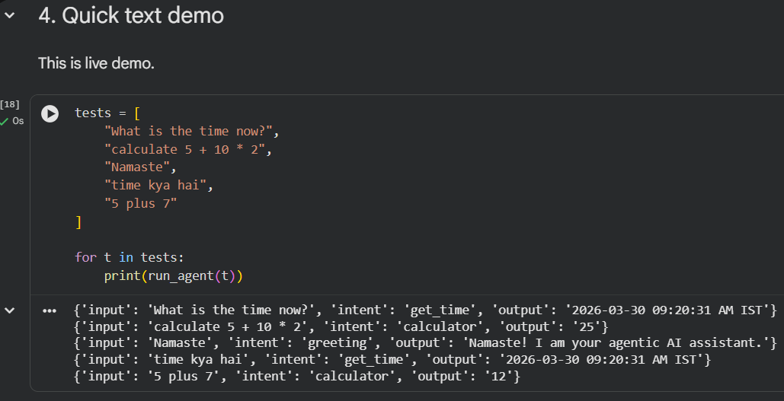
Demo
1. Text input demo
🔗 Open Live Colab Demo

Slide 9
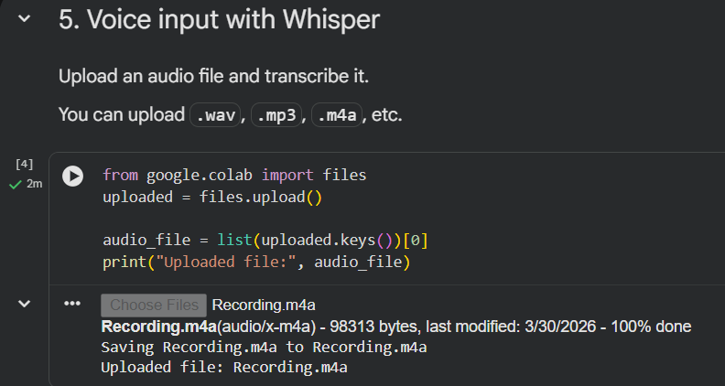
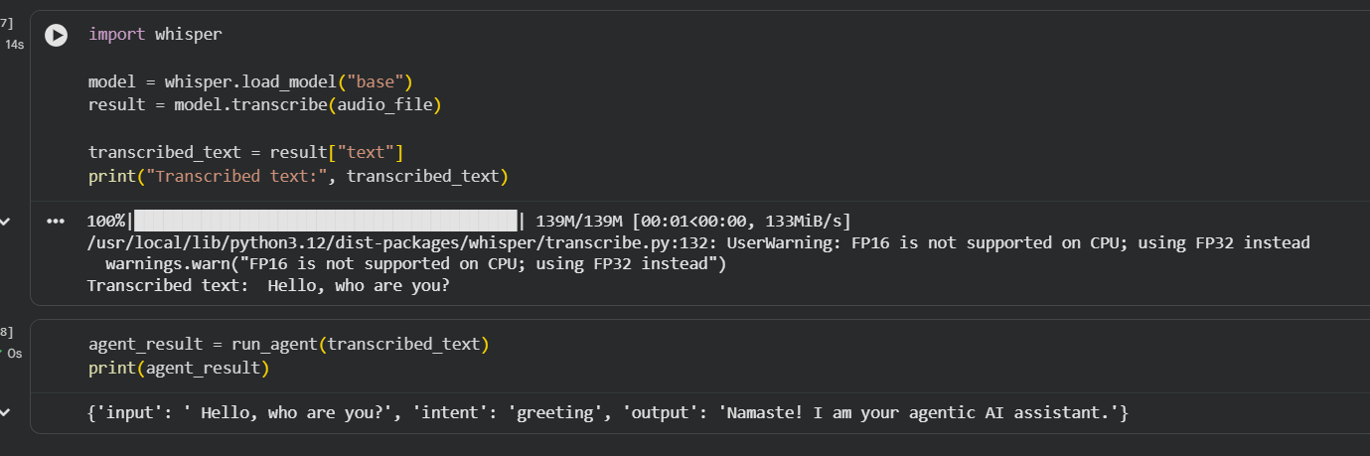
2. Voice input demo using Whisper
🔗 Open Live Colab Demo

Slide 10
Challenges
Audio processing issues
Simple intent detection
Limited tools

Slide 11
Future Scope
Add APIs (booking, maps)
Multi-agent systems
Full automation assistant

Slide 12
Conclusion
Agentic AI enables autonomous task execution.
Step towards real-world AI assistants.

Slide 13
Executive Summary
• Built an agentic AI assistant for Indic voice commands
• Uses Whisper for speech-to-text and LLM-driven intent routing
• Demonstrates autonomous tool usage (time + calculator)
• Supports both text and voice demos in Google Colab
• Strong future scope: API automation, multi-agent workflows

Slide 14
Evaluation Alignment
Problem Understanding → Accessibility gap in Indic voice AI
Implementation → End-to-end working prototype in Colab
Results → Correct tool selection and successful outputs
Viva → Clear distinction between LLMs and agentic systems
Documentation → Structured report with results + references

Slide 15
References
1. OpenAI Whisper: Robust Speech Recognition via Large-Scale Weak Supervision (2022)
2. Hugging Face Transformers Documentation
3. ReAct: Synergizing Reasoning and Acting in Language Models (Yao et al., 2023)
4. LangChain Agents and Tool Calling Documentation
5. Tool-Augmented Language Models for Autonomous Task Execution
6. Review 1 project concept and methodology baseline from submitted PDF

Slide 16
Thank You
Questions & Viva

